Slide 1

Bright Coffee Shop Sales
Amukelani Khosa

Slide 2
Table of Contents
01
Cover PAGE
07
Time classification
04
Revenue Analysis
Jan to Jun Sales
05
Conclusion
05
Sales Per store
Store sales level

Slide 3
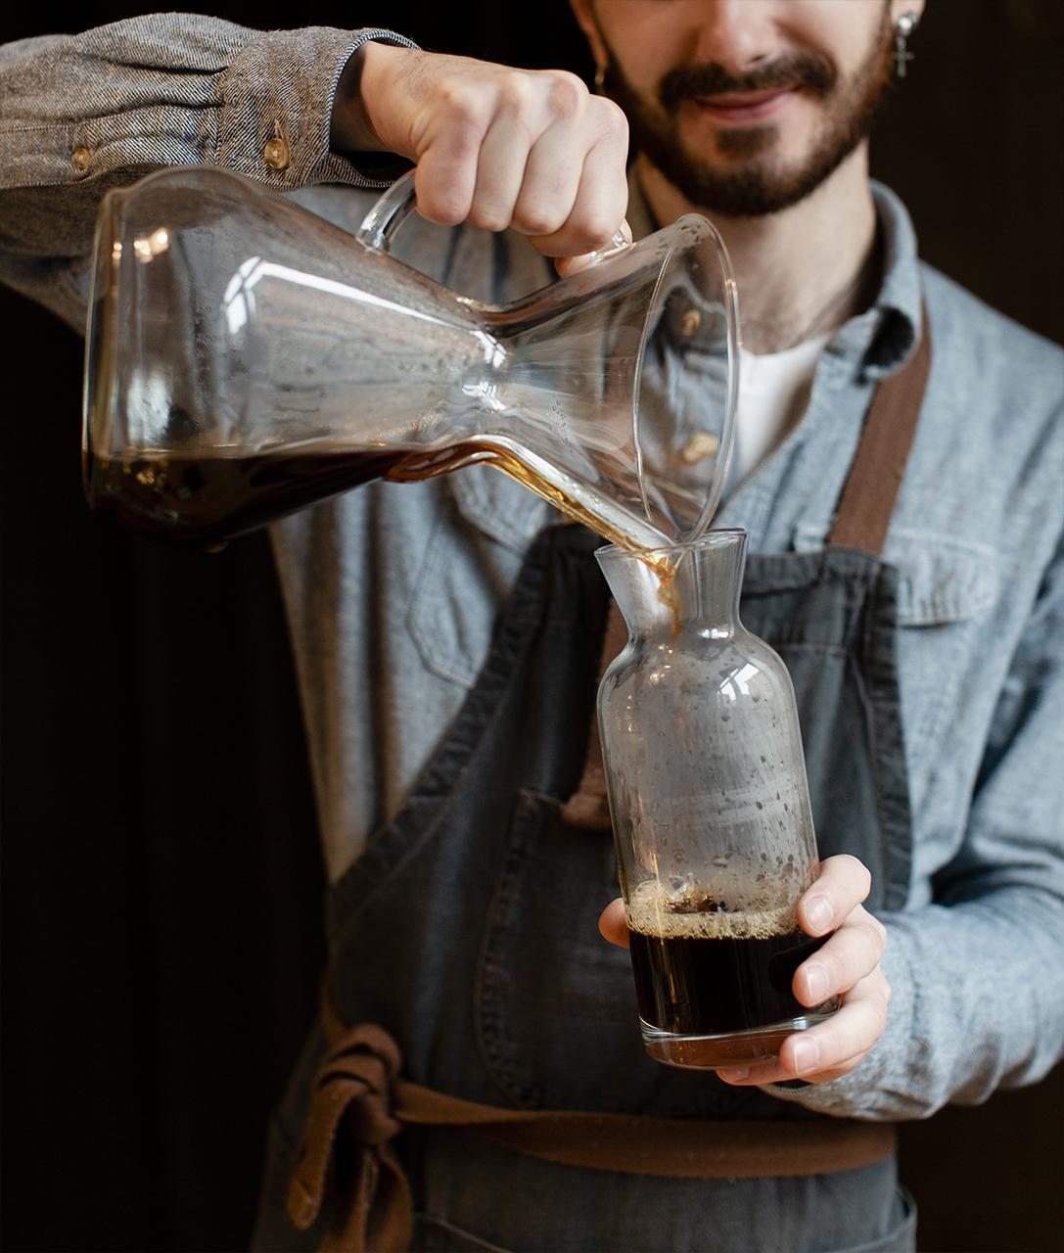
01
Bright Coffee Shop Sales Analysis

Slide 4
Coffee generates more sales than all other products

Slide 5
Revenue Bar Graph

Slide 6
Pie Chart of Revenue By days of the week
Hell’s Kitchen Makes more sales than all other locations

Slide 7
Product Presentation

Slide 8
Sales
Morning
Afternoon
MERCURY
Most sales are made between 06h00 to 11h59 in the morning
Average sales are made Between 12h00 to 16h59
Sales drops between 17h00 and 20h00

Slide 9
3 Different Coffee shops Location
Astoria
Hell’s Kitchen
Lower Manhattan

Slide 11
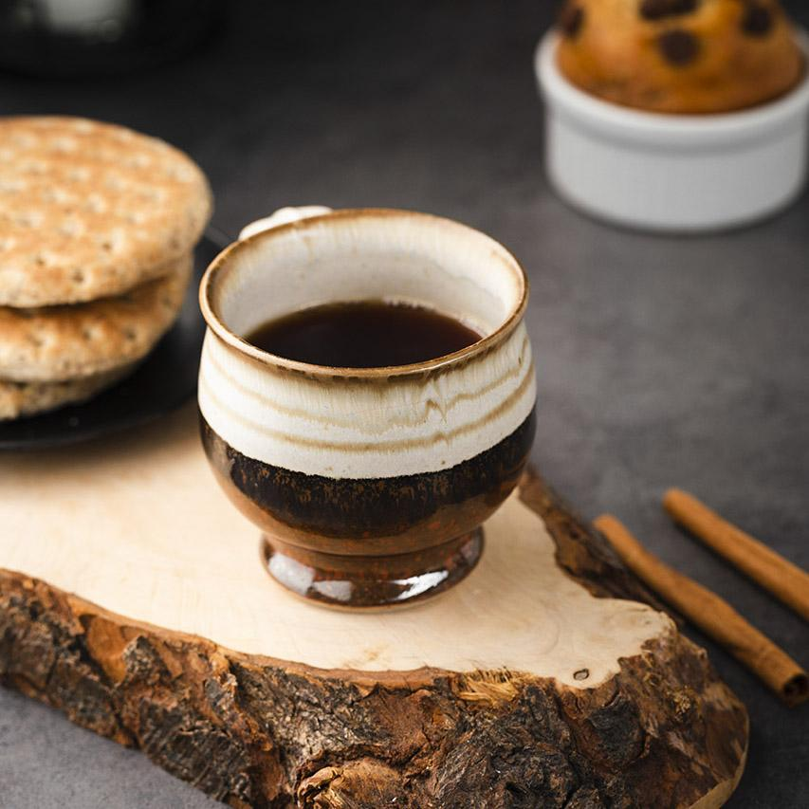
Conclusion
Conclusion
Overall, the sales analysis shows that coffee is the top-performing product, driving the highest revenue across all stores. Hell’s Kitchen stands out as the leading location in sales performance, especially during the morning hours (06h00–11h59) when customer activity peaks. Afternoon sales remain steady, while evening sales experience a noticeable decline. These insights highlight the importance of focusing marketing and operational efforts on morning promotions and enhancing the customer experience at high-performing branches to sustain growth and maximize overall revenue.

